Slide 1
LD 主要性能
激射阈值
发光效率
光谱特征*
远场特征
温度特征
动态特征
－Advanced laser diodes
Notes:
还有：偏振特征
大功率特征。
动态特征相对于稳态，包括：调制特征，噪声特征等。
相对于稳态特征, 在接通和调制时表现出的特征.要求:
谱线不变宽,
模数不增多,
延迟小,
调制快
噪声低
没自持脉冲
光谱特征由激光器的波导模式（横模）和谐振腔（纵模）决定。
电子与光子系统的相互转化, 两个系统的行为可以用速率方程来描述
激光阈值、动态性能分析工具：速率方程

Slide 2
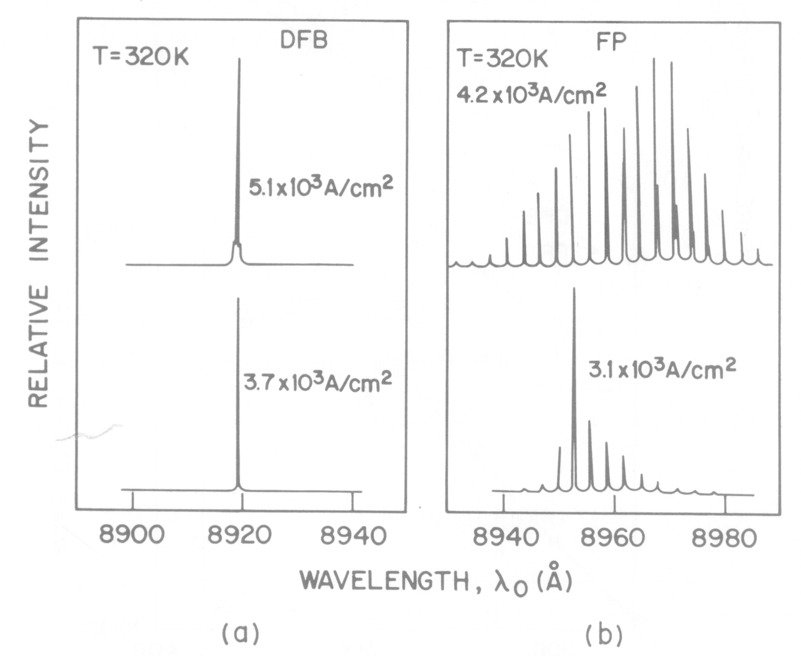
Ch 5.2 Single mode diode laser
Microcavity
DFB
PT
Notes:
只有那些增益达到阈值条件, 而又被谐振腔允许的波长才能形成稳定的激光振荡

Slide 3
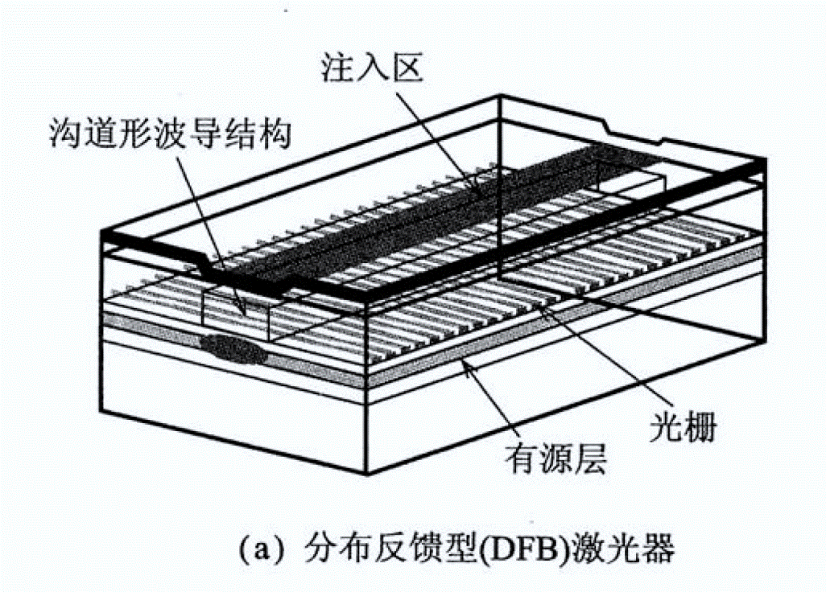
DFB LD
Distributed Feedback
[日] 栖原敏明 半导体激光基础 科学 2002

Slide 4
DFB Single mode LD
折射率微扰
耦合波方程
DFB-LD之本征方程
DFB 激光模式及阈值
Notes:
导波模 -------------------- 辐射模
单模 ------------------------ 单纵模
基模 ------------------------ 基横模
水平横模 ---------------- 垂直横模

Slide 5
Perturbation of refractive index
z
常微扰
（含z）周期微扰

Slide 6
常微扰简单结论
微扰思想:
代入波动方程：
推导见附I
Coldren & Corzine, Diode Lasers and Photonic Integration Circuits ，P675
Notes:
均匀介质微扰（图量子阱）

Slide 7
周期微扰--光栅
s
波导的介电常数：
z
光栅层常微扰
光栅周期微扰
有效介电常数
沿𝑧正向移动𝑠
如果Δε为复数，则 ; 可纯虚，如增益光栅 θ=π/2。
note
Notes:
实际展开有限的相，K 与beta 差别太大，耦合可忽略。

Slide 8
周期微扰：耦合模理论
有光栅：E，H，常规波导：E⁰，H⁰.
z
【日】栖原敏明 半导体激光基础，科学 2002, p187
Notes:
中间，近似为求光功率散度。场算符运算（见电动力学）：叉点减点叉，注意共轭。
最后，在垂直于波导轴的面积无限大，厚度无限小的薄区域积分（常用技巧）。左侧的积分项利用了高斯散度积分定理; 右侧按定义积分。两侧对z微分后，右侧dz消除。

Slide 9
Coupled mode equations
←取
完备性
代入上页公式，并考虑模之正交性和 δβ 的定义式
比对量子力学
正交性 见附II
【日】栖原敏明 半导体激光基础，科学 2002, p187
Notes:
m模朝+z 取正，与前面约定相反
含加光栅层后的直流偏离δβ
利用到δβ的计算公式，栖原书P107，式5.92；类ucsb 书之结果，即前文常微扰情形。
思路与量子力学之含时周期微扰理论高度一致，结果亦是。

Slide 10
光栅中场的形式
设：
参考常规波导的β及增益
-β
β
失谐量
-β₀
β₀
耦合的相位匹配条件
布拉格条件
[日] 栖原敏明 半导体激光基础 科学 2002，p185
Notes:
单（横）模波导
无微扰波导－有效折射率求解例
g 为增益系数。
有效折射率与模式对应, 由波导结构和折射率分布决定

Slide 11
DBF激光器中的耦合模方程
代入耦合模方程：
Notes:
前行波，指数上正号；与钟锡华同；与UCSB 反。
A_{f}, A_{b}, 分别与 E_{m} ，E_{n} 对应, n=-m
！！耦合模方程右侧指数部分来自 Δε的傅里叶展开：理论上无穷展开，实际只展开为m,-m两项的和。代入耦合系数后有2beta+2K 项，这项高频振荡，对耦合无贡献，弃之**。
按日书：β_{m} 即 -β (实应定义为β_{-m})；β_{n} 即 β;
按照通常的符号法则 β_{m} 和β_{n} 应互换
复传播常数，
模增益系数

Slide 12

耦合模方程之求解
（改写为失谐形式）
（合理假设解的形式）
代入前页A_{f}，A_{b}微分公式
得到矩阵形式的特征方程
$$本征值:$$

Slide 13

DFB波导模式
通解：
前行
后行
简正模式(Normal mode)为前进波和后进波耦合而成.
$$传播常数:$$
Notes:
通解？Af写成正负gama两项之和，Ab 也是。由本征方程，规定了F 与B的关系。
简正模式：

Slide 14

DFB中光波模式的色散关系（无增损）
$$前行波,在无增益和损耗时$$
β=β₀ , Δ=0： β_{DFB} 无实数解
布拉格波长的光波不被允许
远离𝛽=𝛽₀; 弱耦合，忽略𝜅时, β_{DFB}
回归普通（常）波导
[日]栖原敏明 半导体激光基础
Notes:
Δ=0, β为复数解, 衰减波, 此处不存在稳定的模式，带隙出现,即模式劈裂

Slide 15
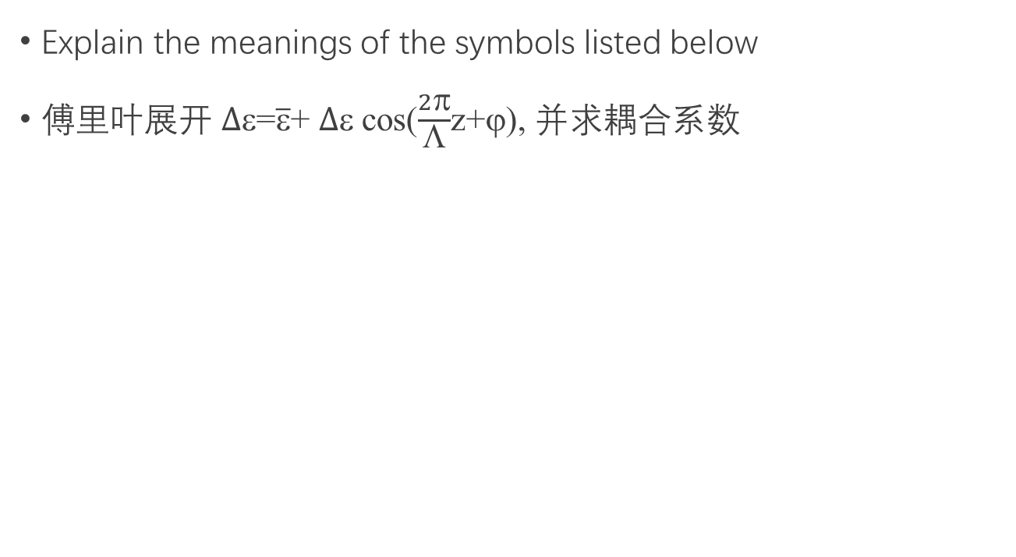
Exercise（canceled）
Explain the meanings of the symbols listed below
傅里叶展开 $∆$=$\overline{ε}$+ $∆$cos($\frac{2π}{Λ}$z+ϕ), 并求耦合系数

Slide 16
折射率DFB中光波模式的色散关系
耦合
[日]栖原敏明 半导体激光基础 P189.
Coldren & Corzine, Diode Lasers and Photonic Integration Circuits,p347
Notes:
无微扰向前和向后的波
有微扰,耦合区
光栅导致传播常数平移，
但远离布拉格传播常数，
无耦合

Slide 17
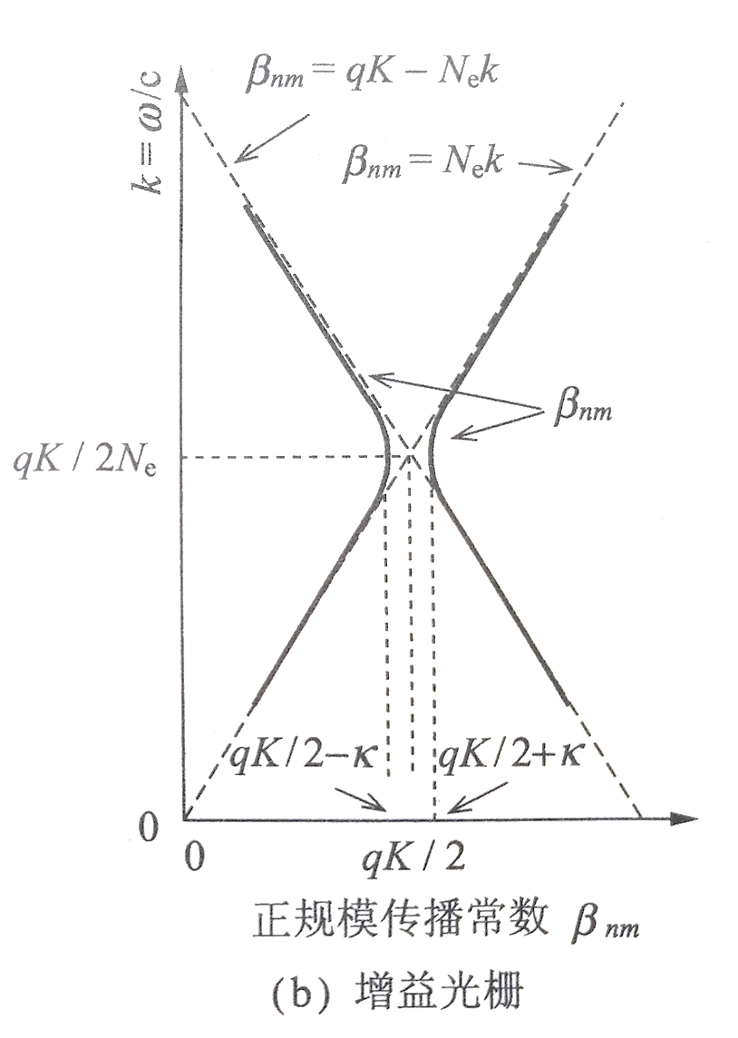
增益DFB光栅中光波模式的色散关系
θ=±π/2
标准模β:
↓
无禁带
[日]栖原敏明 半导体激光基础 P189

Slide 18
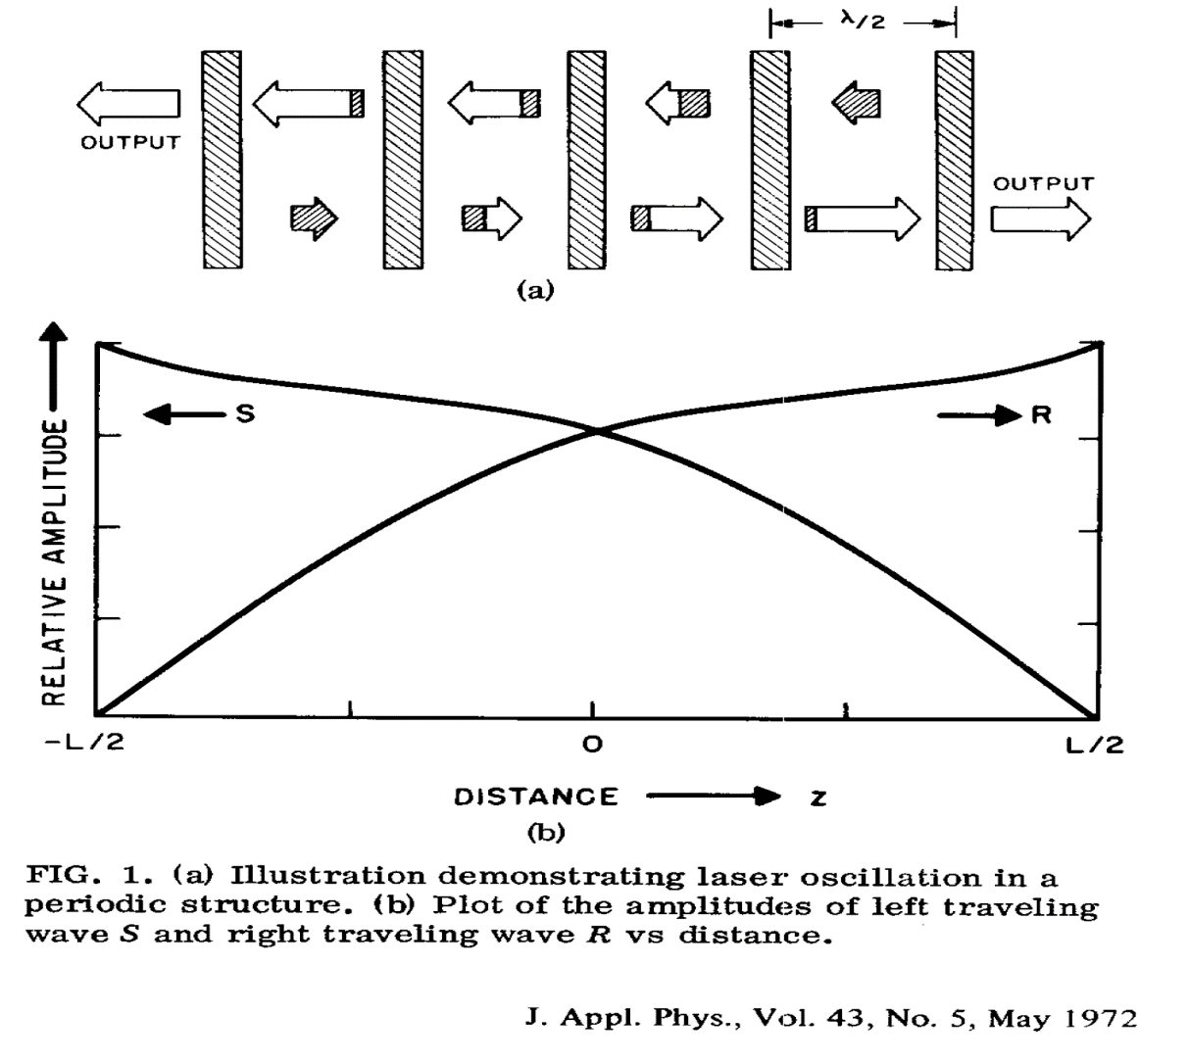
耦合之物理图象(有增益)
E_{b}
E_{f}
2327

Slide 19
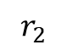
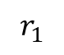
边界条件
$$r_{1}$$
$$r_{2}$$
L
z
@ z=0
@ z=L

Slide 20
本征方程
边界条件决定了关于F，B 的线性方程组
非零解条件:
本征方程
[日]栖原敏明 半导体激光基础 P192.

Slide 21
DFB激光器中的激射波长与阈值
两端无反射时，r₁,r₂=0:
激射条件通式
折射率光栅
则
不满足激射条件(同前文)
[日]栖原敏明 半导体激光器基础
Notes:
振幅条件

Slide 22
激射条件
因
激射条件可写为：
消去
在弱耦合极限下κ→0，
激射条件
相位条件
m=1,2,3…
振幅条件
[日]栖原敏明 半导体激光器基础
Notes:
双曲正弦函数：sinh(x)=(e^{-x}-e^{-x})/2

Slide 23
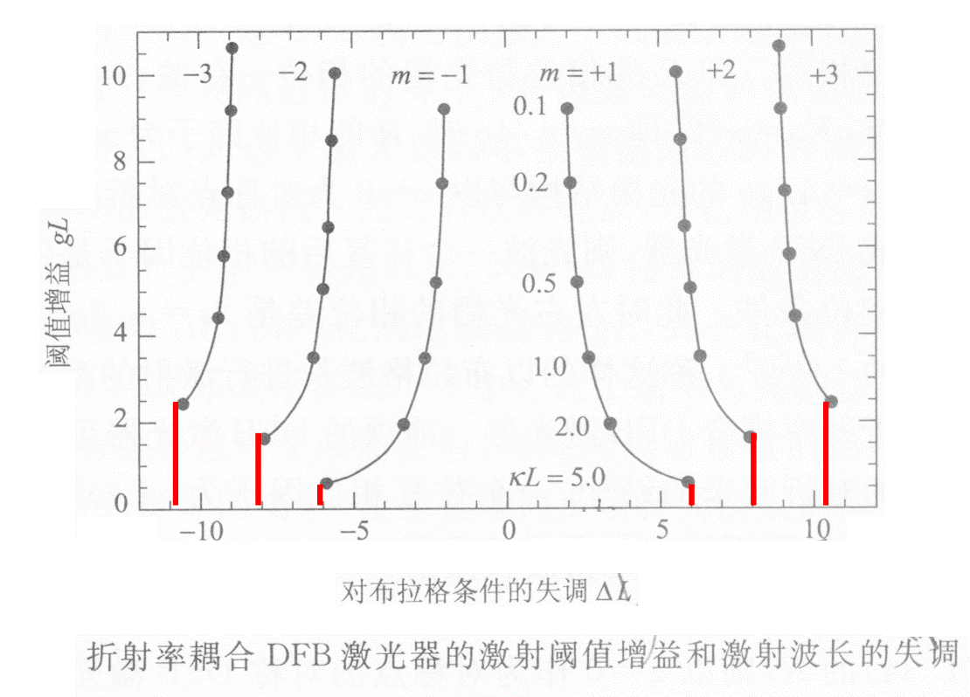
DFB-LD模式及阈值—耦合强弱
[日]栖原敏明 半导体激光器基础

Slide 24
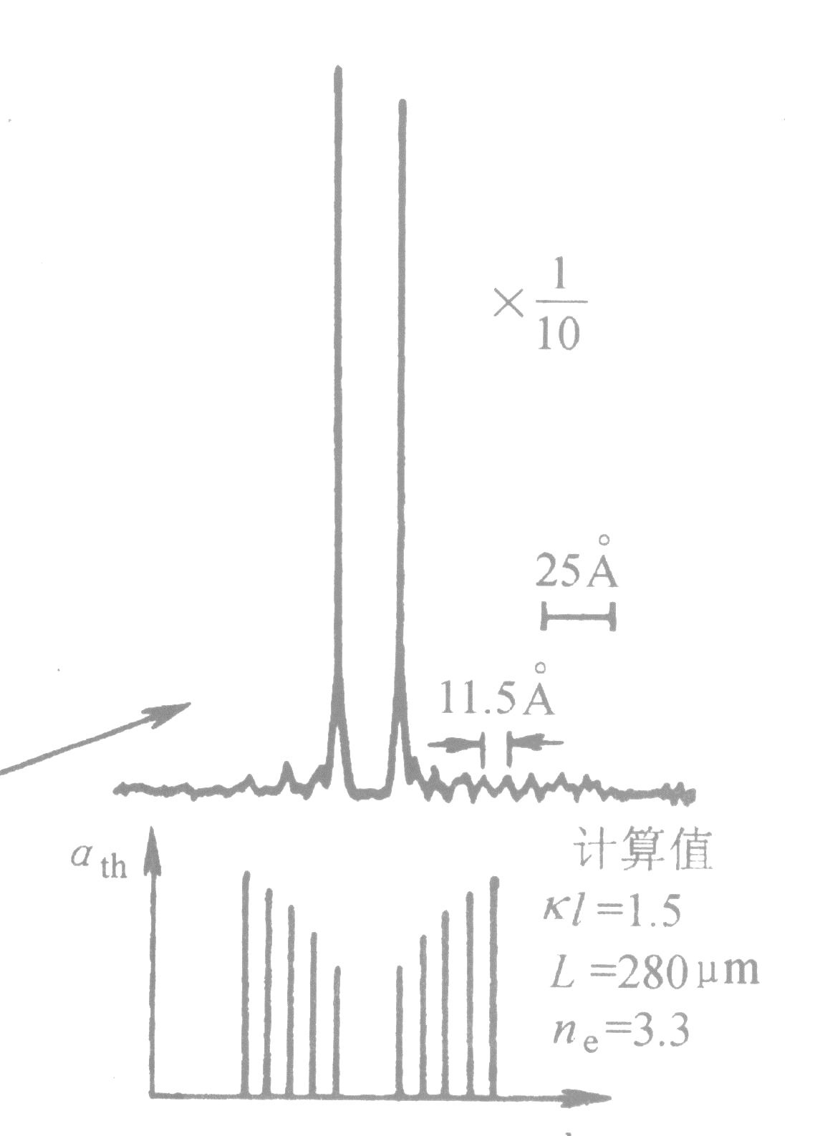
例：DFB激光激射波长与阈值
q=1,2…
对于一级光栅
对于q 级光栅
黄德修 半导体光电子学
Notes:
振幅条件

Slide 25
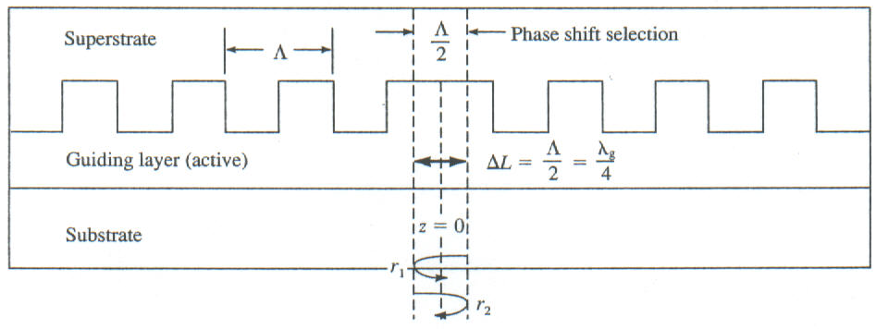
λ/4 DFB如何消除模式简并
E_{f}
E_{b}
z
前行波与后行复振幅之比（光栅中的模式公式和 L 处反射为零）：
[ ]内为实数
令
则
折射率光栅
Notes:
第一等号是定义；第二等号利用了L处场为零的条件：Ef=0 → Eb2/Eb1=e-2iγL; 第三等号的附加位相从rG1中引入。讨论：deltB=0, gamma=±iκ,如果s=0,位相差为π；如果s=lammd/4, 则相位差为2π。

Slide 26
λ/4相移 DFB如何消除模式简并
s=0, 连续光栅, r的位相为±i； 往返一次，相位为±1
s=qΛ/4, r位相为±1, 2L范围的光栅中往返一次, 位相为(±1)²
令上式 r=±1, 则用反射公式直接求得：
Δ=0，对于基模,m=0,上式成立!
[日] 栖原敏明 半导体激光物理基础P195

Slide 27
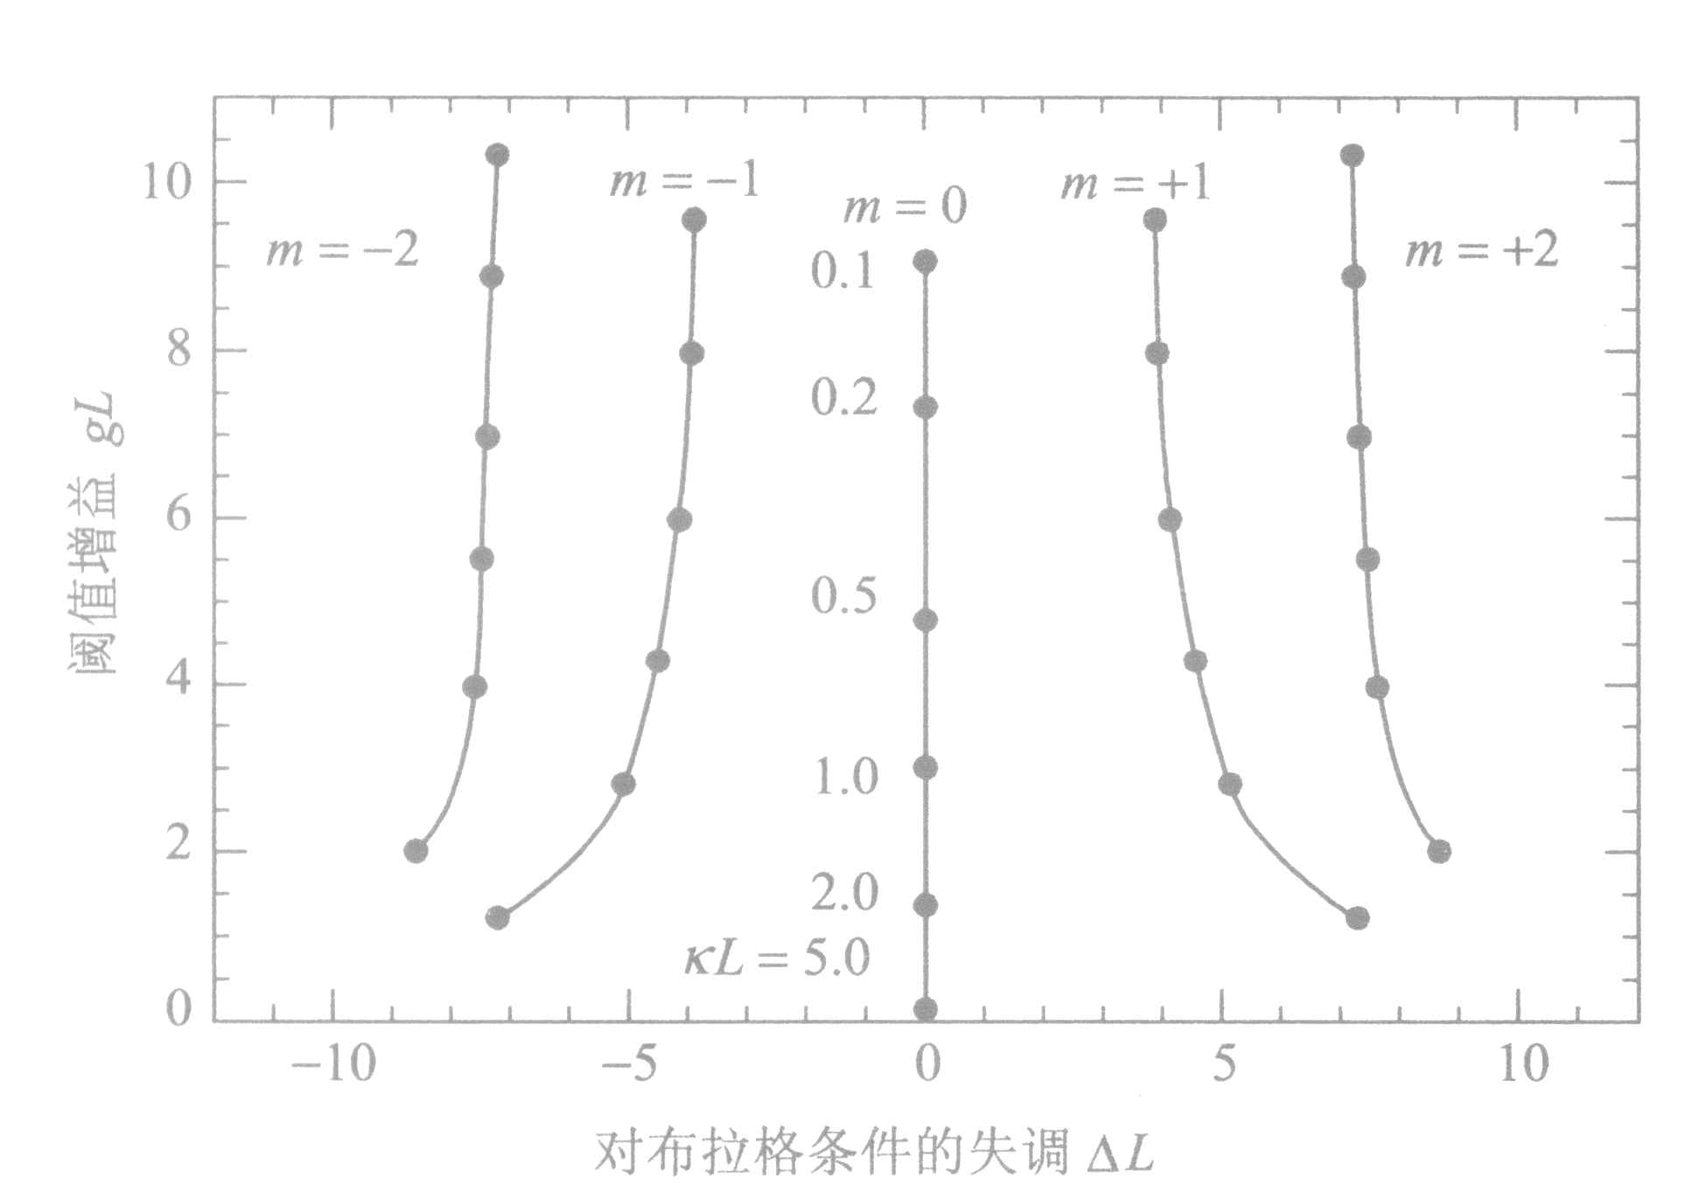
λ/4 shift DFB的模式及阈值增益
Notes:
一级光栅：m=1， Λ₁=0.23 μm
二级光栅：m=2， Λ₂=0.46 μm

Slide 28
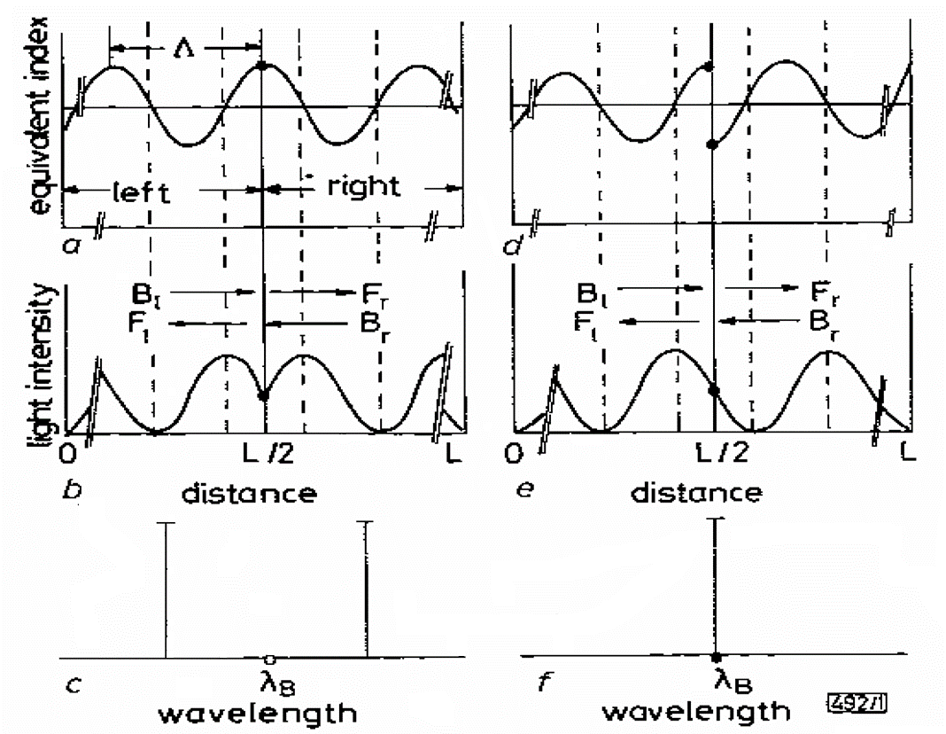
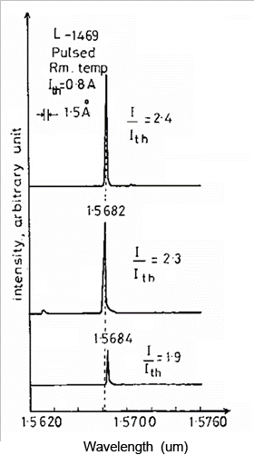
λ/4 shift DFB简并解除的直观图
80
Notes:
λ/4 shift DFB
的改进:
异节距光栅
取样光栅
超结构光栅

Slide 29
增益DFB激光器
增益光栅
有可能激射
激射条件

Slide 30
增益DFB激光器激射条件
消去
在弱耦合极限下κ→0，满足激射的条件是:
相位条件
q=0,±1, ± 2, ± 3…
振幅条件
可激射
[日]栖原敏明 半导体激光器基础 p197

Slide 31
增益DFB激光器激射条件

Slide 32
DFB LD 小结
耦合波方程
DFB LD 本征方程
DFB LD激射条件

Slide 33
PT single mode Laser
μ
ε₁
ε₂
Optical properties
Notes:
光子学的终极故事：介电常数的设计与利用

Slide 34
Parity time photonics
Hermitian Quantum mechanics
V(x), real
Non-Hermitian Quantum mechanics
Parity time photonics
Notes:
Non-Hermitian Quantum mechanics

Slide 35
PT operation
P:
T:

Slide 36
Hermitian → Non-Hermitian
Hermitian
Non-Hermitian
n_{R}
x
x
n_{R}
n_{I}
z
z
n_{I}
Real spectrum
PT symmetry: Real spectrum
PT symmetry broken: complex spectrum
Breaking threshold

Slide 37
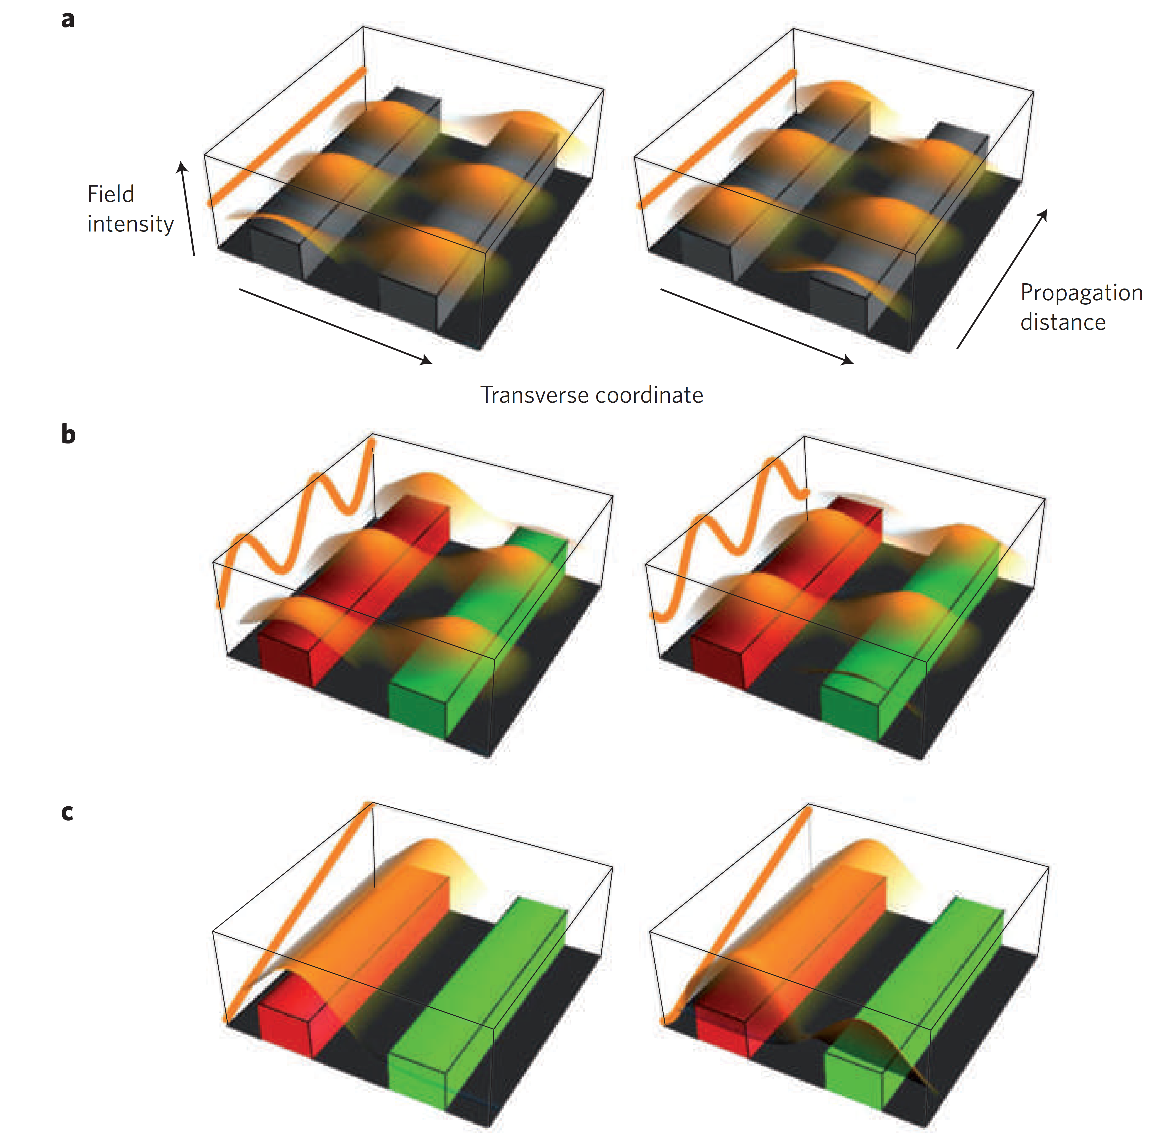
PT symmetry breaking
Two coupled waveguide
PT symmetry: Real spectrum
γ> γ_{PT}
PT symmetry broken: complex ~
Broken symmetry makes light work
NATURE PHYSICS 6: 166-167（2010）
Notes:
Figure 1 | Light propagation in a PT material. Rüter et al.1 have designed a coupled-waveguide system
in which PT-related concepts (such as spontaneous PT-symmetry breaking) can be observed. Left
(right) panels correspond to initial excitation in the left (right) waveguide in each case. Waveguides
are colour-coded according to the gain/loss parameter (γ): grey for passive (γ = 0), red for gain and
green for loss. a, In a passive system, the propagation is reciprocal and the total power (orange line)
remains constant. b, In a system for which γ <γPT, PT symmetry is exact and the non-reciprocity of
beam propagation can be seen in the variation of total power. c, For γ > γPT (broken-PT phase), beam
power grows exponentially (vertical scale is logarithmic), whereas the beam propagation is again nonreciprocal
with respect to the mirror axis of the two waveguides.

Slide 38
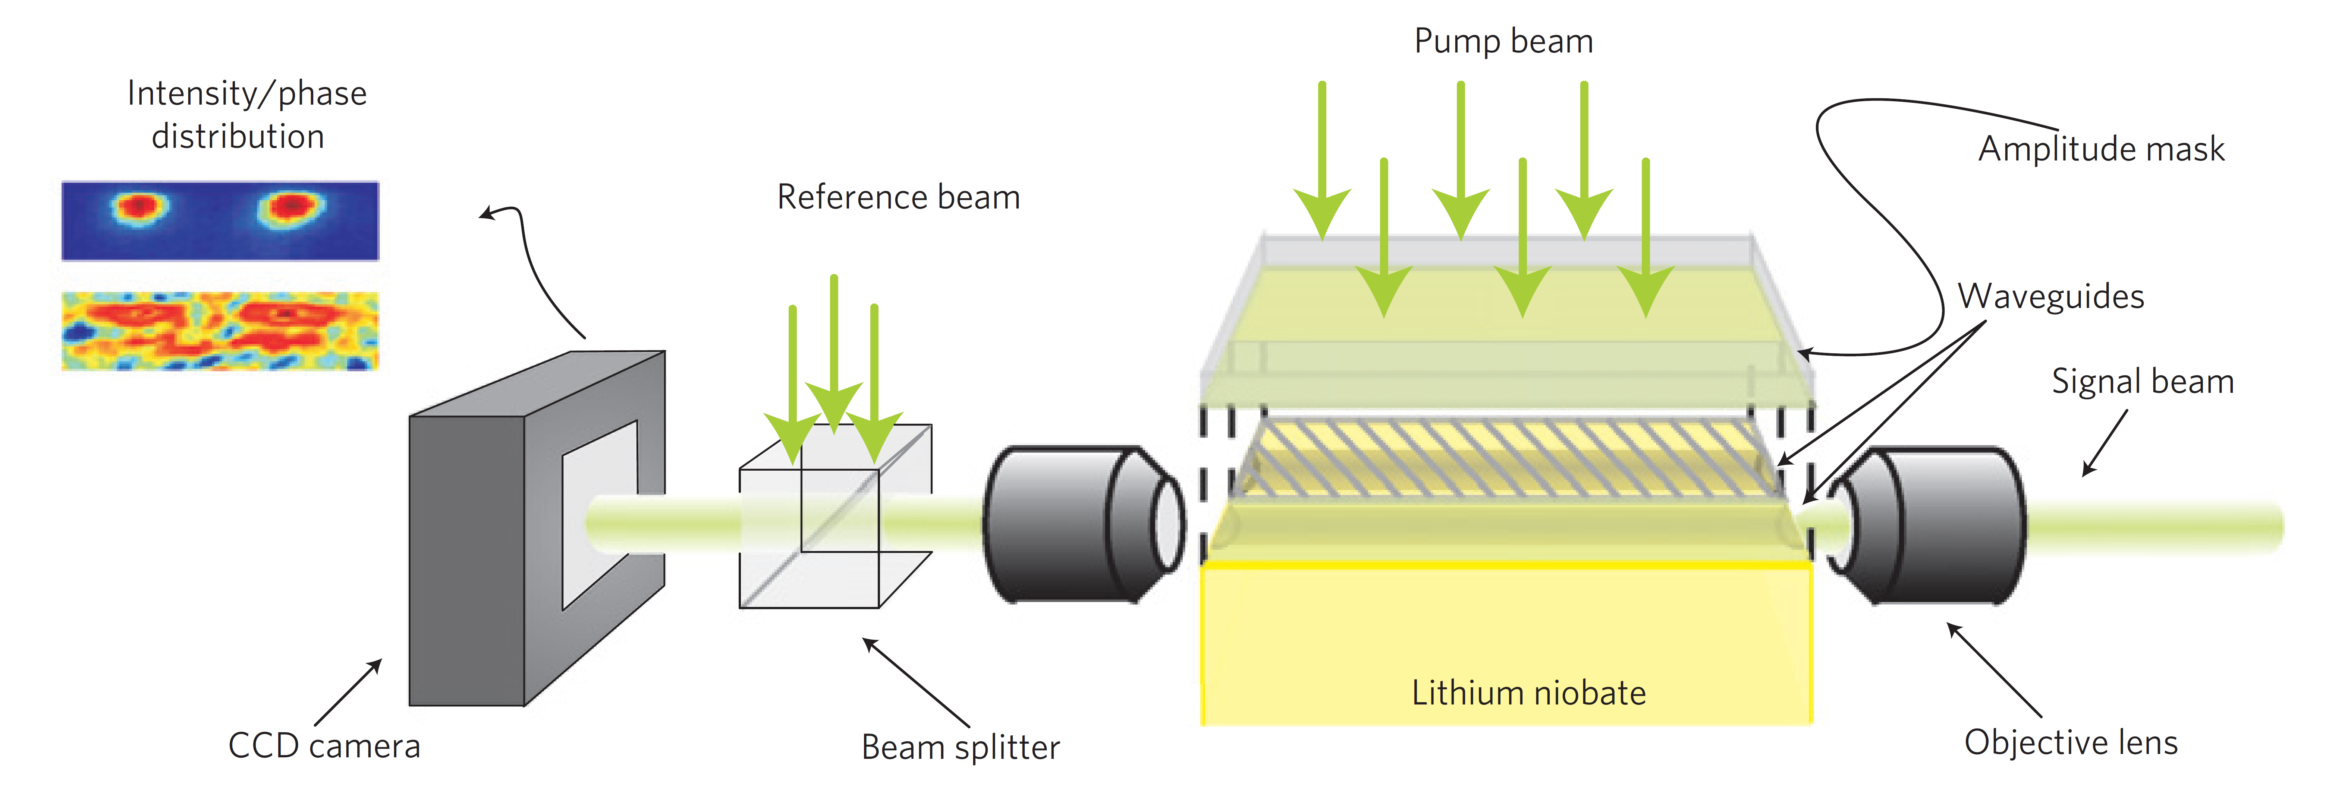
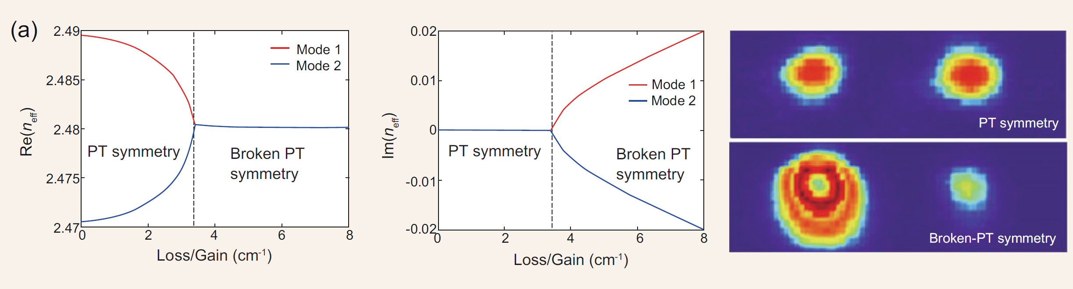
PT symmetry breaking
Observation of parity–time symmetry in optics. Nat Phys 2010; 6:192–5.

Slide 39
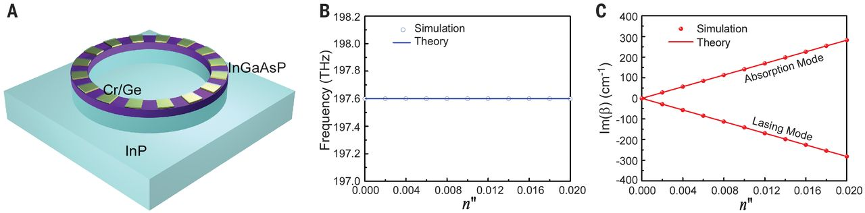
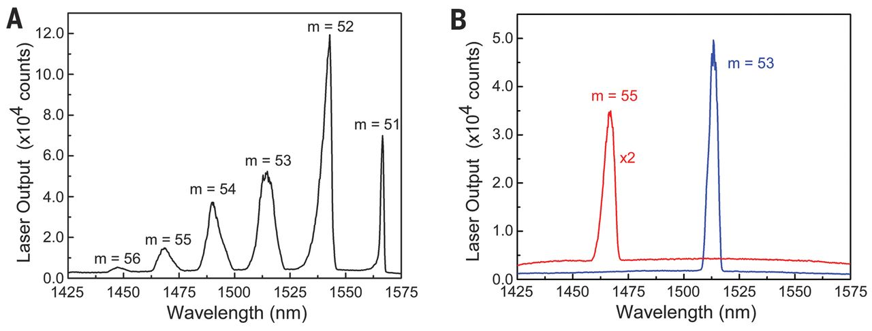
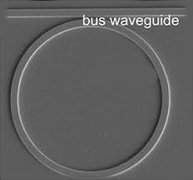
Single-mode laser by PT symmetry breaking
SCIENCE (21 NOV 2014) 346, 972
Notes:
Design of PTmicroring lasers. (A) Schematic of the PTmicroring laser, which consists of Cr/Ge bilayer structures arranged periodically in the azimuthal direction on top of the InGaAsP/InP microring resonator to mimic a pure gain/loss modulation.The diameter and width of the microring resonator are 8.9 mm and 900 nm, respectively. The microring also extends 1 mm deeper into the InP substrate. Here, the designed azimuthal order is m = 53 to achieve the resonant wavelength around 1500 nm. (B and C) The same eigenfrequency (197.6 THz) and complex conjugate imaginary eigenspectra for the two modes at m = 53 determined by numerical simulations (circles and dots) and theoretical calculations (solid lines). The onset in (C) indicates thresholdless PT symmetry breaking.
-------------------------------------------------------------------------------------------------------
Comparison between PT laser and typical microring laser. (A) Multimode lasing spectrum
observed from the typical microring WGM laser, showing a series of lasing modes corresponding to
different azimuthal orders. (B) Single-mode lasing spectra of the PTmicroring lasers operating at the
m = 53 and m = 55 azimuthal orders, consistent with the lasing wavelength for the same azimuthal
orders in (A). This confirms that our PT microring laser does not alter original WGMs but efficiently
selects the desired lasing mode

Slide 40
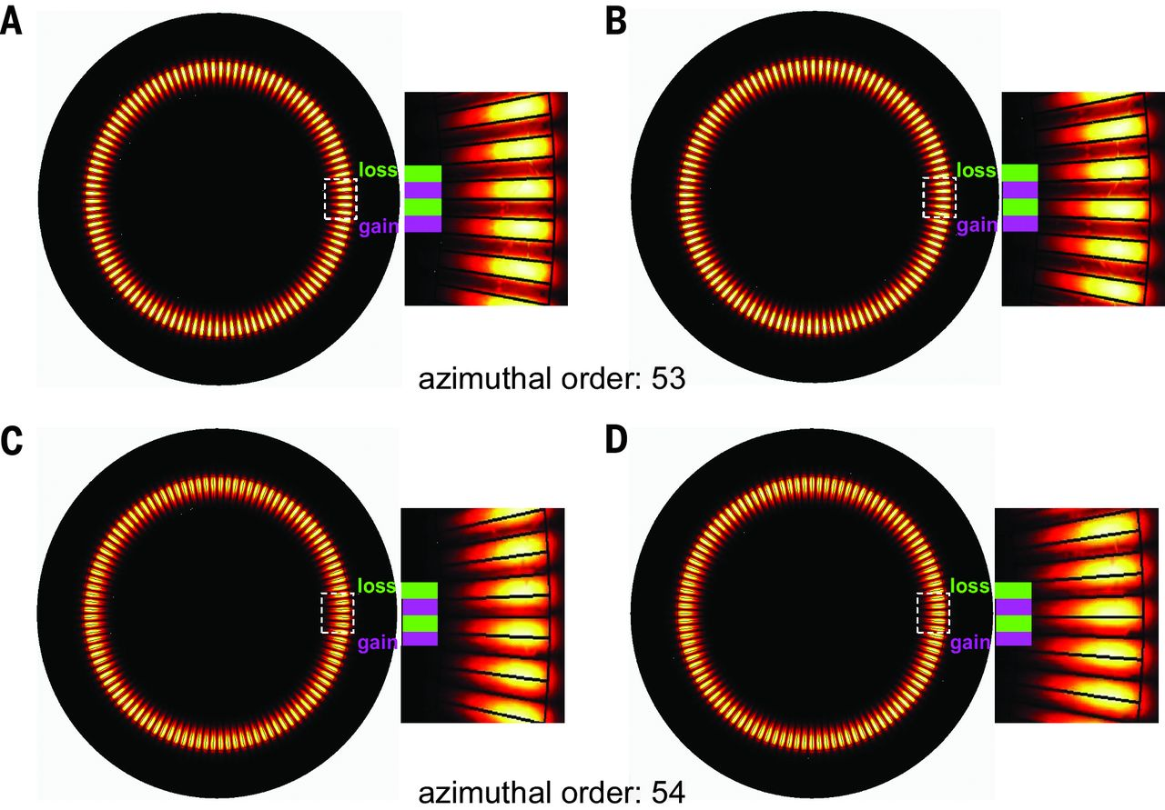
Single-mode laser by PT symmetry breaking
A, B: m= 53, effective gain of 268 cm⁻¹ and effective loss of –268 cm⁻¹
C,D: m = 54. eigenfrequency of 200.9
Notes:
WGMs of different azimuthal orders in the PT microring laser. (A and B) Eigen–electric field
intensity distributions of paired lasing and absorption modes at m = 53. Fields are confined in the gain (A)
and loss (B) sections, resulting in conjugate modal gain/loss coefficients: effective gain of 268 cm−1 [Im(b) =
–134 cm–1] for the lasing mode (A) and effective loss of –268 cm−1 [Im(b) = 134 cm–1] for the absorption
mode (B). (C and D) Eigen–electric field intensity distributions of paired WGMs at m = 54.The two modes
share the same eigenfrequency of 200.9 THz and a similarmodal loss coefficient of –8 cm−1 [Im(b) = 4 cm–1].

Slide 41
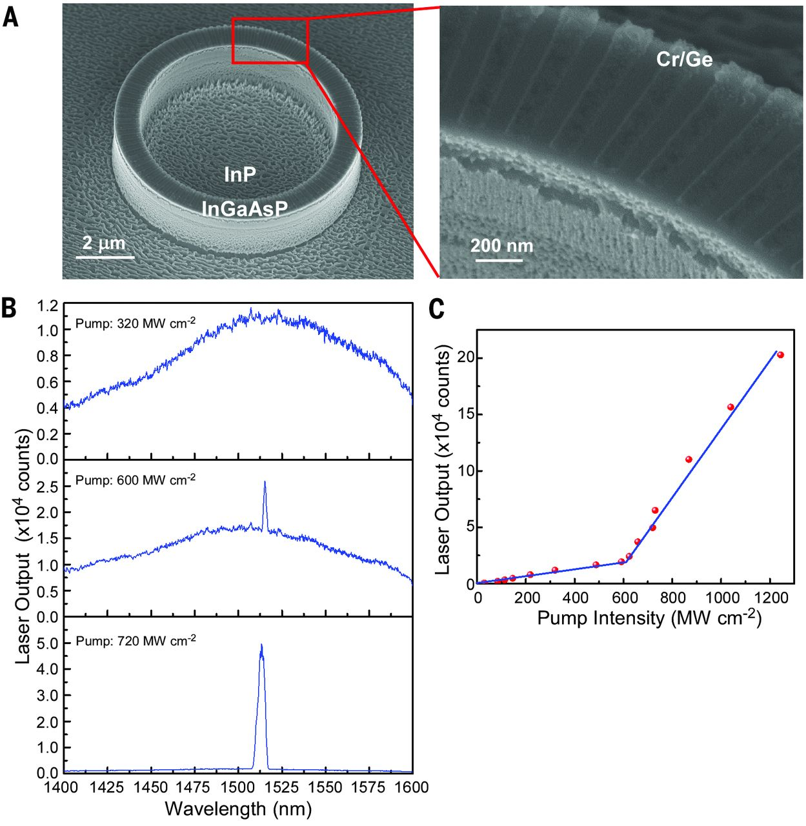
Single-mode laser by PT symmetry breaking
Single-mode!
Notes:
A) Scanning electron microscope
images of the fabricated PT microring
laser. (B) Evolution of the light emission spectrum
from photoluminescence to amplified
spontaneous emission and then to singlemode
lasing at a wavelength of about 1513 nm,
shown as the peak power density of pump light was increased from 320 MWcm−2 to 600 MWcm−2 and
then to 720 MW cm−2. (C) Light-light curve of the PT microring laser shows the power relationship
between the lasing emission and the pump light. A clear onset of the intrinsic single-mode lasing appears
at a threshold slightly larger than 600 MW cm−2.

Slide 42
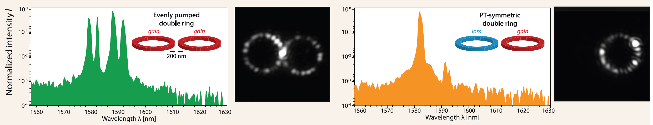
Parity–time symmetric photonics
National Science Review 5: 183–199, 2018
SCIENCE 976 21 NOVEMBER 2014 • 346
Notes:
Experimental observation of mode suppression by PT-symmetry breaking. (A) Emission
spectrum of a single resonator (radius 10 mm, ring width 500 nm, height 210 nm) when exposed to a peak
pump power of 4.9mW. (B) Corresponding intensity pattern within the ring as observed fromscattered light.
(C) Spectrum obtained from an evenly pumped pair of such rings (4.9 mW + 4.9 mW). (D) The intensity
pattern shows that both resonators equally contribute. (E) Single-moded spectrum under PT-symmetric
conditions (0 mW + 4.9 mW pump). The mode suppression ratio exceeds 20 dB. (F) Lasing exclusively
occurs in the active resonator.The single ring has a free spectral range of ~ 9.9 nmand aQ-factor of ~2 × 105.
The measured linewidth of the single ring laser is ~ 0.12 nm, limited by the spectrometer resolution.

Slide 43
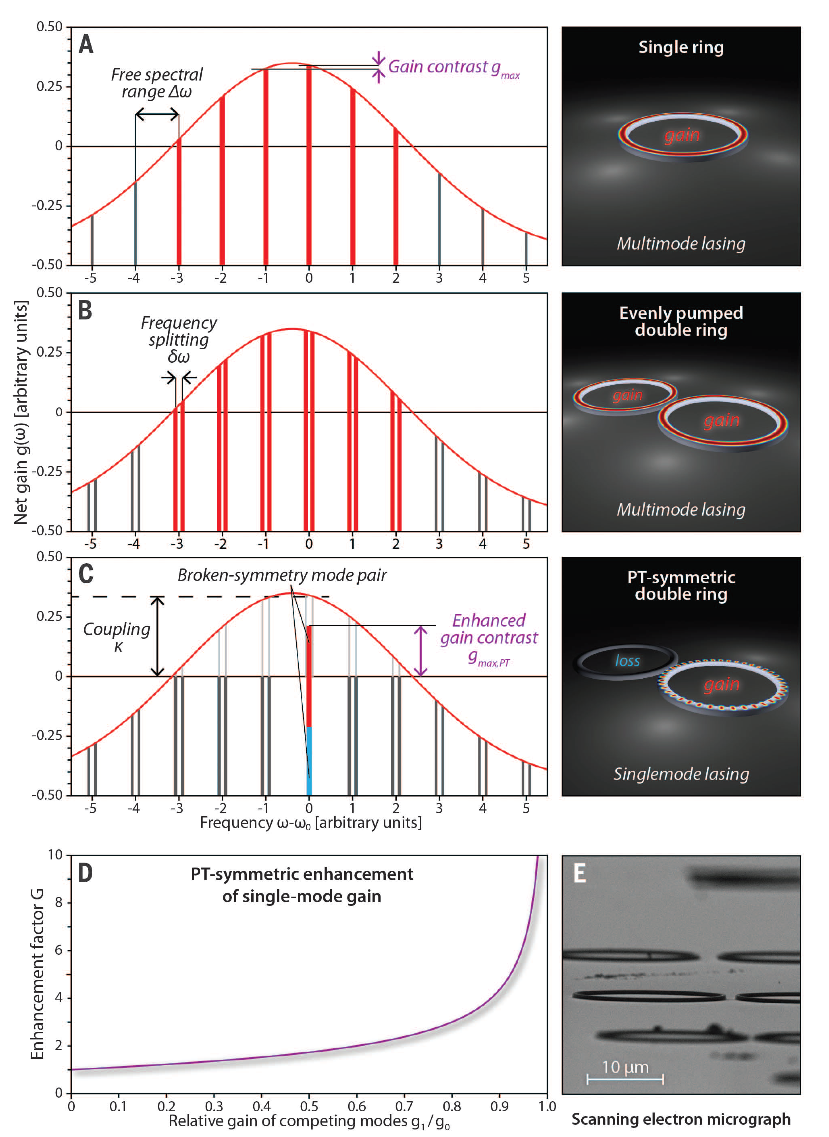
SCIENCE 976 21 NOVEMBER 2014 • 346
Notes:
Principle of mode suppression in PT-symmetric microring lasers. (A) An isolated ring resonator
allows lasing of all longitudinal modes with positive net gain. To achieve single-mode operation, the
maximum permissible gain is limited by the contrast between the resonances. (B) In a coupled
arrangement of two identical and evenly pumped rings, the degeneracy of resonator modes is broken
and mode pairs emerge. (C) PT-symmetric arrangement: As long as the coupling exceeds the amplification,
loss and gain in the two respective rings balance each other, whereas above this threshold, PT
symmetry breaking occurs.This mechanism can be exploited to enforce stable single-mode operation in
otherwise highly multimoded resonators. (D) Enhancement factor G of the maximum achievable differential
gain for single-mode operation in a PT-symmetric setting compared to a single active resonator.
(E) Scanning electron microscope image of a typical set of coupled microring resonator pairs.

Slide 44
SUMMARY
Single mode diode laser
DFB
PT （Microcavity）
Notes:
只有那些增益达到阈值条件, 而又被谐振腔允许的波长才能形成稳定的激光振荡

Slide 45
Exercises（选）
P139，(5.19) A laser diode emits at 830nm when operating at an injection current of 100 mA.
(a) Calculate the maximum possible power that can be emitted by the device.
(b) Calculate the power conversion efficiency, if the actual power output is 50mW and the operating voltage is 1.9 V.
(c) The threshold current of the laser is 35 mA. What is the slope efficiency and the quantum efficiency?
调研：
市场上，最短波长的半导体激光器激光器的波长是多少，所用材料是什么？最长波长的是多少，用的什么材料。

Slide 46
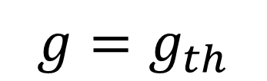
光增益的钳制
$$g=g_{th}$$
增益系数随光子密度和电子密度的反方向变化
高于阈值后, 新增加的电流全部用于产生受激发射, 锁定了载流子浓度,进而锁定了光增益.
Notes:
光增益系数随光子密度和电子密度的反方向变化
新增电子产生受激辐射光子

Slide 47
附I: 常折射率微扰公式推导
均匀介质微扰（图量子阱）
代入横模波动方程：
化简, 并略去二阶小量:

Slide 48
续
两侧同乘U*, 然后在垂直z向的无穷大平面上积分 (常用技巧)
右第二积分项为零,或可忽略,下证之。
先对横模方程取复共轭再右乘ΔU得:
这样,上积分方程中右第二积分项中的后两小项作代换为
(对于实数的ε和β) :

Slide 49
续
上式右第一积分项:
路经之处为无穷远，ΔU，U 为零
上上式右第二积分项: 为零, 对于实数的ε和β
证毕

Slide 50


附II：波导本征模式的正交完备性
$$波导中本征模：$$
$$波导附近的任意场：$$
Notes:
偏振-振幅-横侧向场分布-传播特点-负号正向（-beta*z）

Slide 51
附II：模式的正交性与功率流
证明中用到模式正交性的如下表达形式
把光功率流归一化为1𝑊
证明如下：
设波导无损耗，有两模式
设其横模场为
栖原敏明书，P94，式5.29

Slide 52
续
上式积分可用斯托克斯定理转换为包含原积分区域的xy 平面内的环路积分，积分路径远离轴时，场为零，故，上式积分为零。同下式：
电磁场的横方向是正交的
【日】栖原敏明 半导体激光基础，科学 2002, p94

